Slide 1



CORONA VIRUS
ANALYSIS

Slide 2
CORONA VIRUS
The crisis had a dramatic impact on global poverty and inequality. Global poverty increased for the first time in a generation, and disproportionate income losses among disadvantaged populations led to a dramatic rise in inequality within and across countries.

Slide 3


DATA DESCRIPTION
Description of each column in dataset:
Province: Geographic subdivision within a country/region.
Country/Region: Geographic entity where data is recorded.
Latitude: North-south position on Earth's surface.
Longitude: East-west position on Earth's surface.
Date: Recorded date of CORONA VIRUS data.
Confirmed: Number of diagnosed CORONA VIRUS cases.
Deaths: Number of CORONA VIRUS related deaths.
Recovered: Number of recovered CORONA VIRUS cases.

Slide 4


CREATE SCHEMA
Create a database/schema named corona.
Select the database that you want to work with the USE function.
OUT PUT

Slide 5

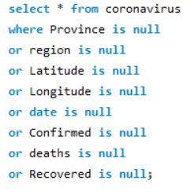
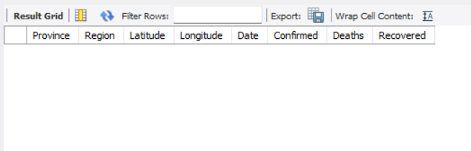
QUERY 1
To avoid any errors, check missing value / null value . Write a code to check NULL values
OUT PUT

Slide 6


QUERY 2
If NULL values are present, update them with zeros for all columns.
OUT PUT
No Null Values in the dataset

Slide 7



QUERY 3
check total number of rows
OUT PUT

Slide 8
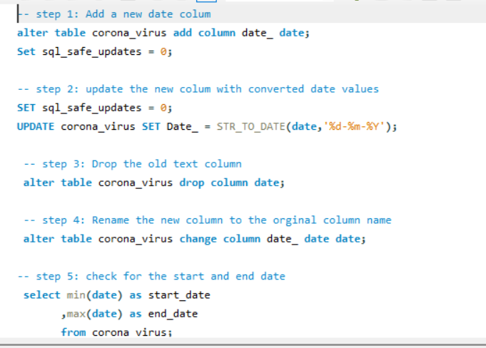
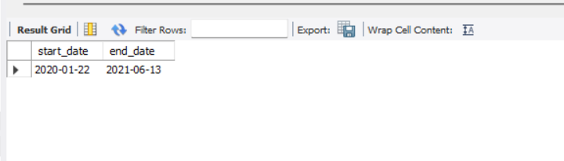

QUERY 4
Check what is start date and end date
OUT PUT

Slide 9
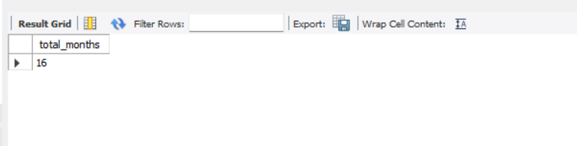
QUERY 5
Number of month present in dataset
OUT PUT

Slide 10
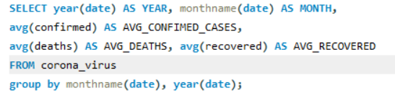
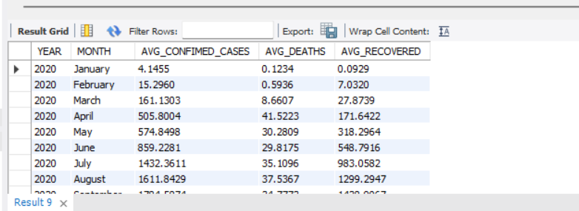
QUERY 6
Number of month present in datasetFind monthly average for confirmed, deaths, recovered
OUT PUT

Slide 11
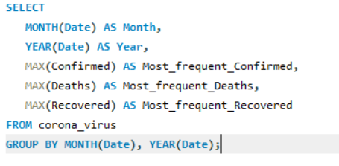
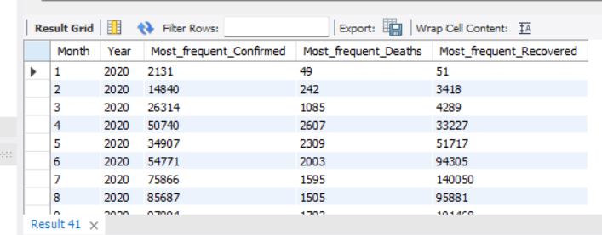

QUERY 7
Find most frequent value for confirmed, deaths, recovered each month
OUT PUT

Slide 12

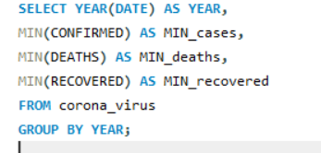

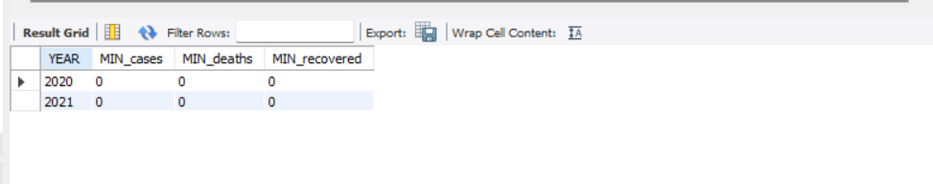
QUERY 8
Find minimum values for confirmed, deaths, recovered per year
OUT PUT

Slide 13
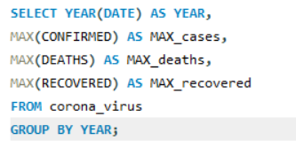

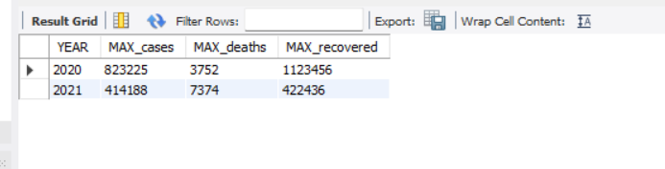
QUERY 9
Find maximum values of confirmed, deaths, recovered per year
OUT PUT

Slide 14
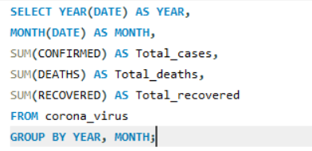

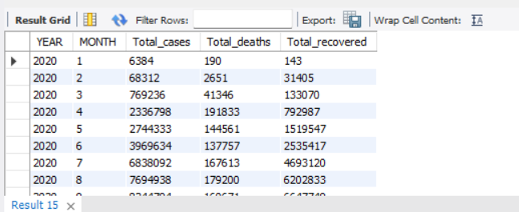
QUERY 10
The total number of case of confirmed, deaths, recovered each month
OUT PUT

Slide 15

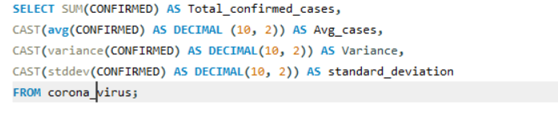
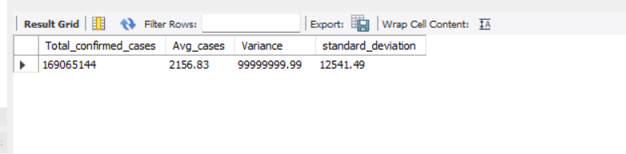
QUERY 11
Check how corona virus spread out with respect to confirmed case(Eg.: total confirmed cases, their average, variance & STDEV )
OUT PUT

Slide 16
QUERY 11
Check how corona virus spread out with respect to confirmed case(Eg.: total confirmed cases, their average, variance & STDEV )
OUT PUT

Slide 17
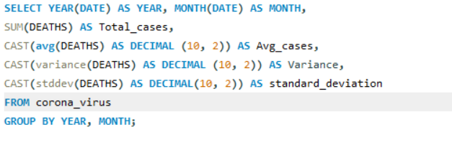

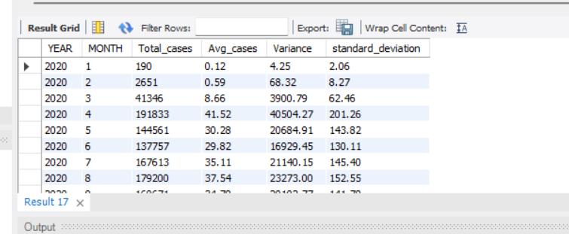
QUERY 12
Check how corona virus spread out with respect to death case per month
(Eg.: total confirmed cases, their average, variance & STDEV )
OUT PUT

Slide 18
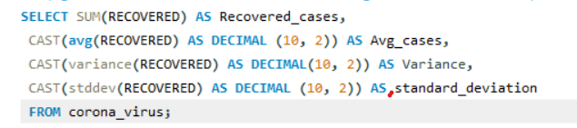

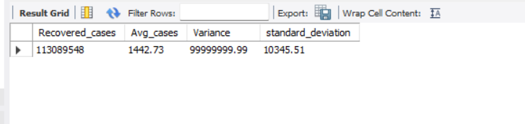
QUERY 13
Check how corona virus spread out with respect to recovered case
(Eg.: total confirmed cases, their average, variance & STDEV )
OUT PUT

Slide 19
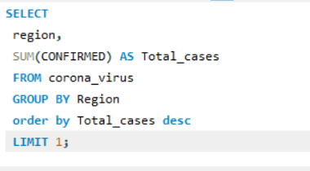

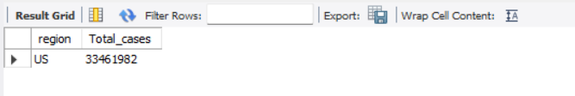
QUERY 14
Find Country having highest number of the Confirmed case
OUT PUT

Slide 20
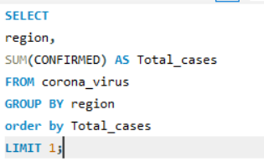

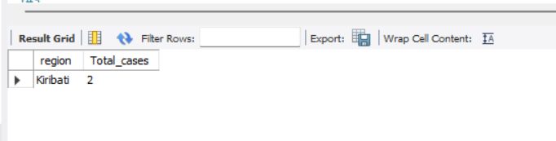
QUERY 15
Find Country having lowest number of the death case
OUT PUT

Slide 21

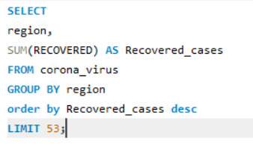
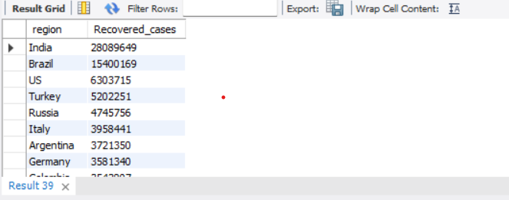
QUERY 16
Find top 5 countries having highest recovered case
OUT PUT

Slide 22


